Slide 1
Failure Curve Analytics SAP APM

Slide 2

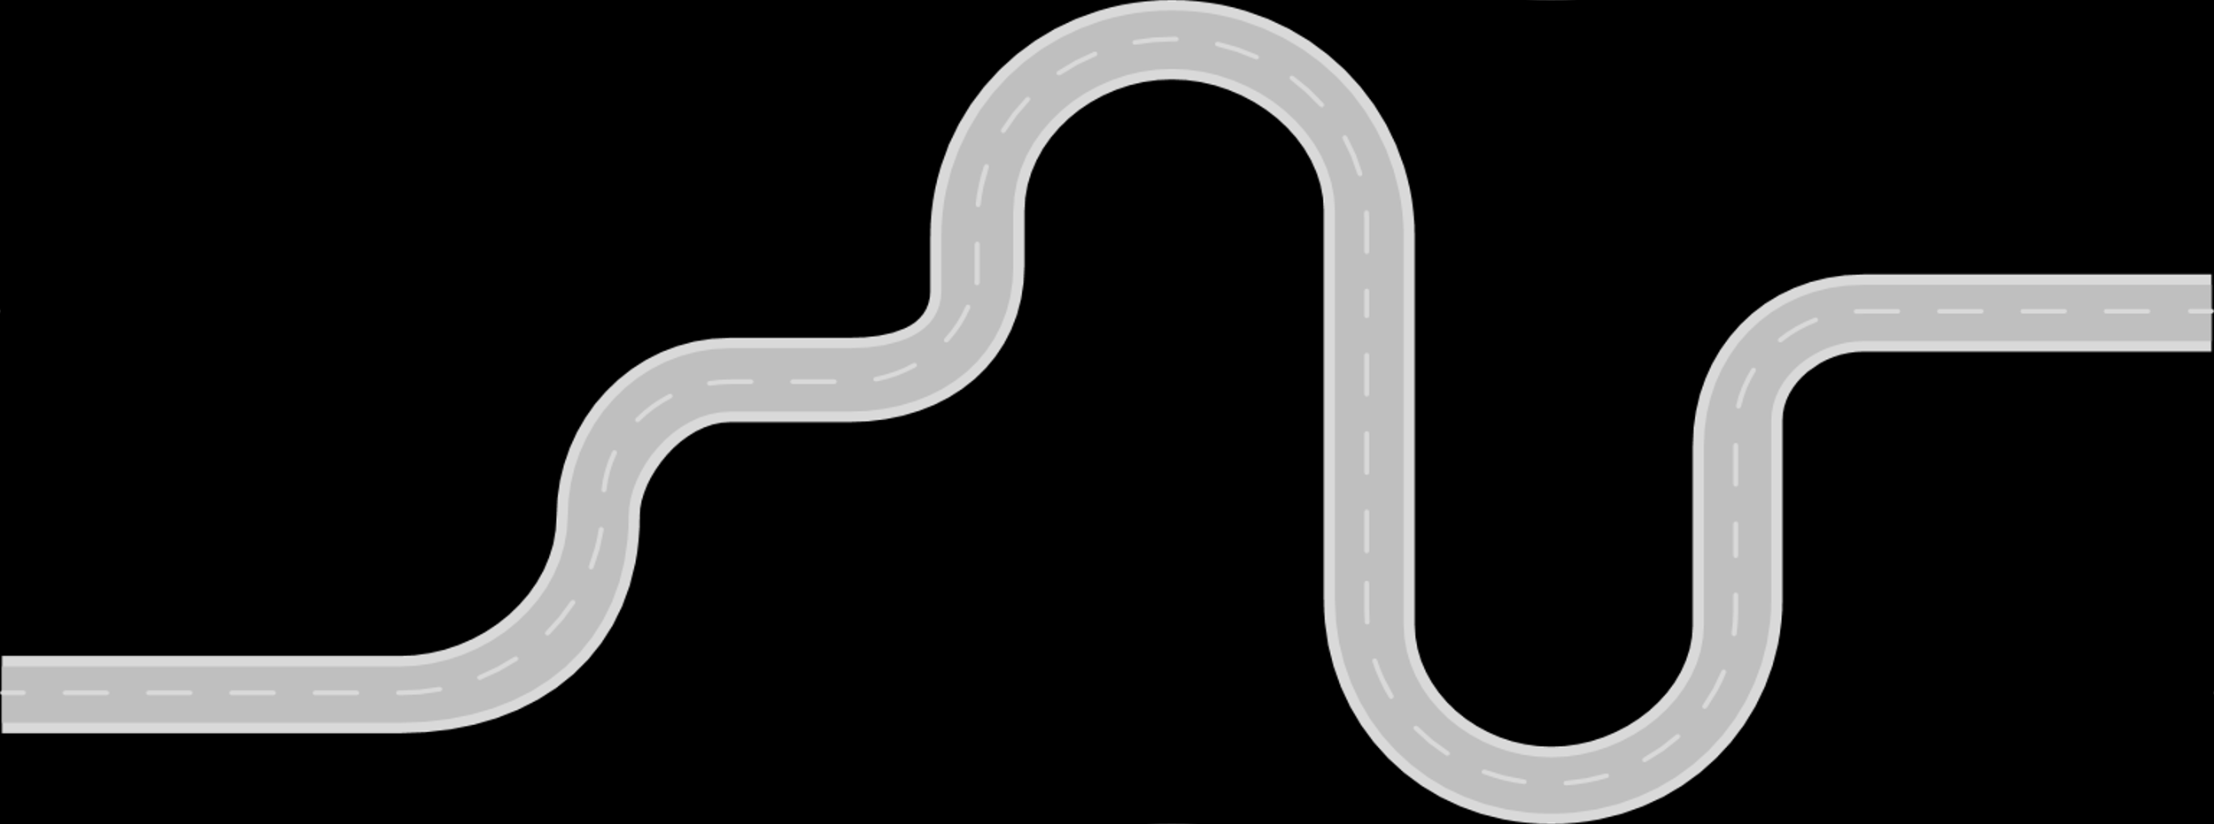

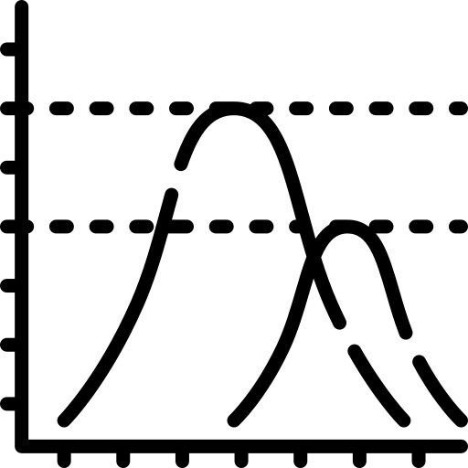



Failure Curve Analytics
Configuring Failure Curve Analytics
Rule
Monitoring Alert
Configure Failure Curve Analytics
Explore Techincal Objects
Create Model Trainning
Visualize
Failure Curves Analytics
Configure Failure Curve Analytics
Create Group
Train and Score

Slide 3
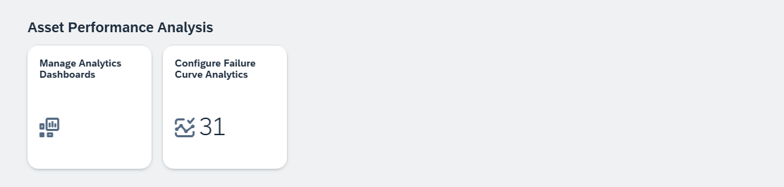
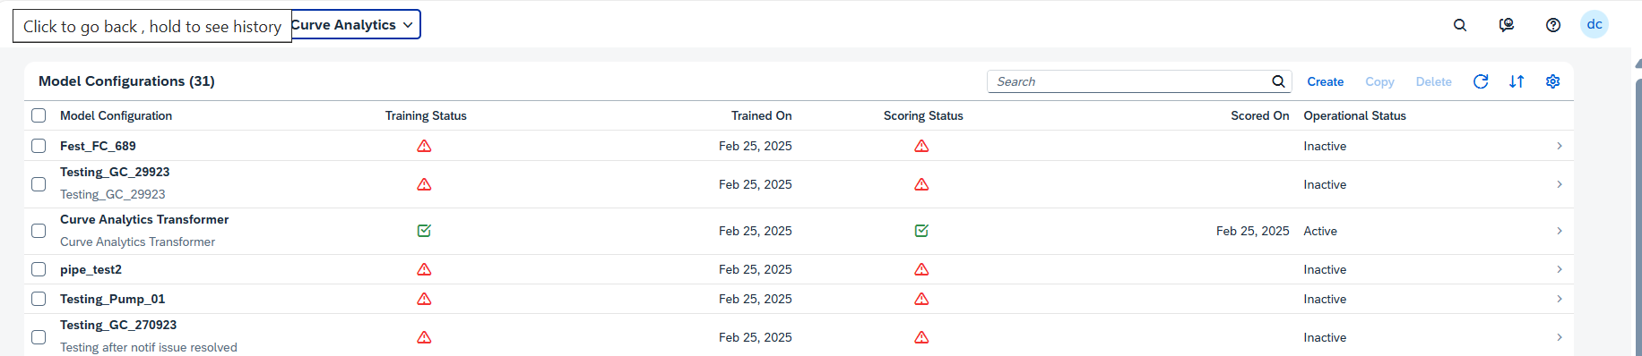
How to create a Failure Curve Analytics? Step by Step

Slide 4
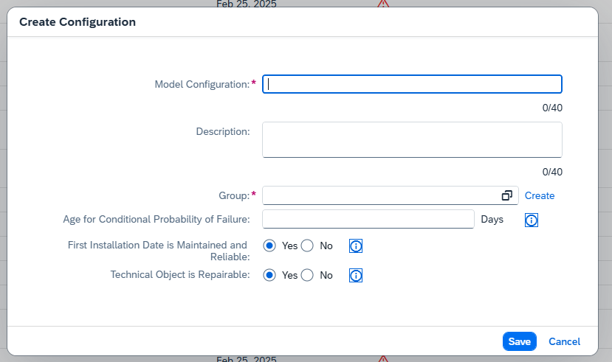
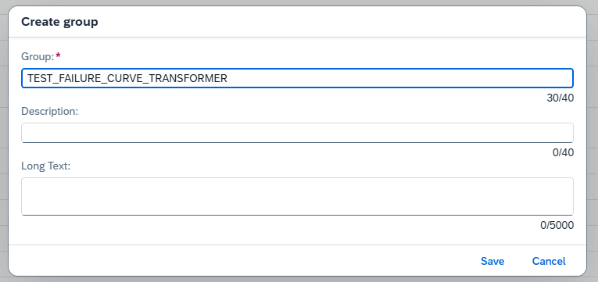
How to create a Model and Group? Step by Step

Slide 5
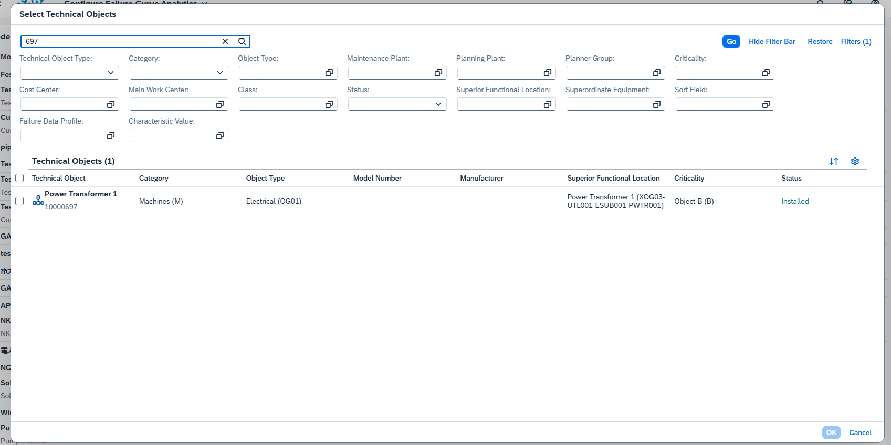
How to create a Group? Step by Step

Slide 6
Creating a Model Training
Model Configuration
Sets the initial parameters for the model to define its behavior and integration within the system.
Group
Categorizes the model under a specific group, such as a type of equipment, for better organization.
Age of Conditional Probability of Failure
Defines the age at which the probability of failure begins to change based on the asset's condition.
First Installation Date is Maintained and Reliable
Specifies the first installation date and whether it’s reliable for accurate lifecycle calculations.
Technical Object is Repairable
Categorizes the model under a specific group, such as a type of equipment, for better organization.

Slide 7
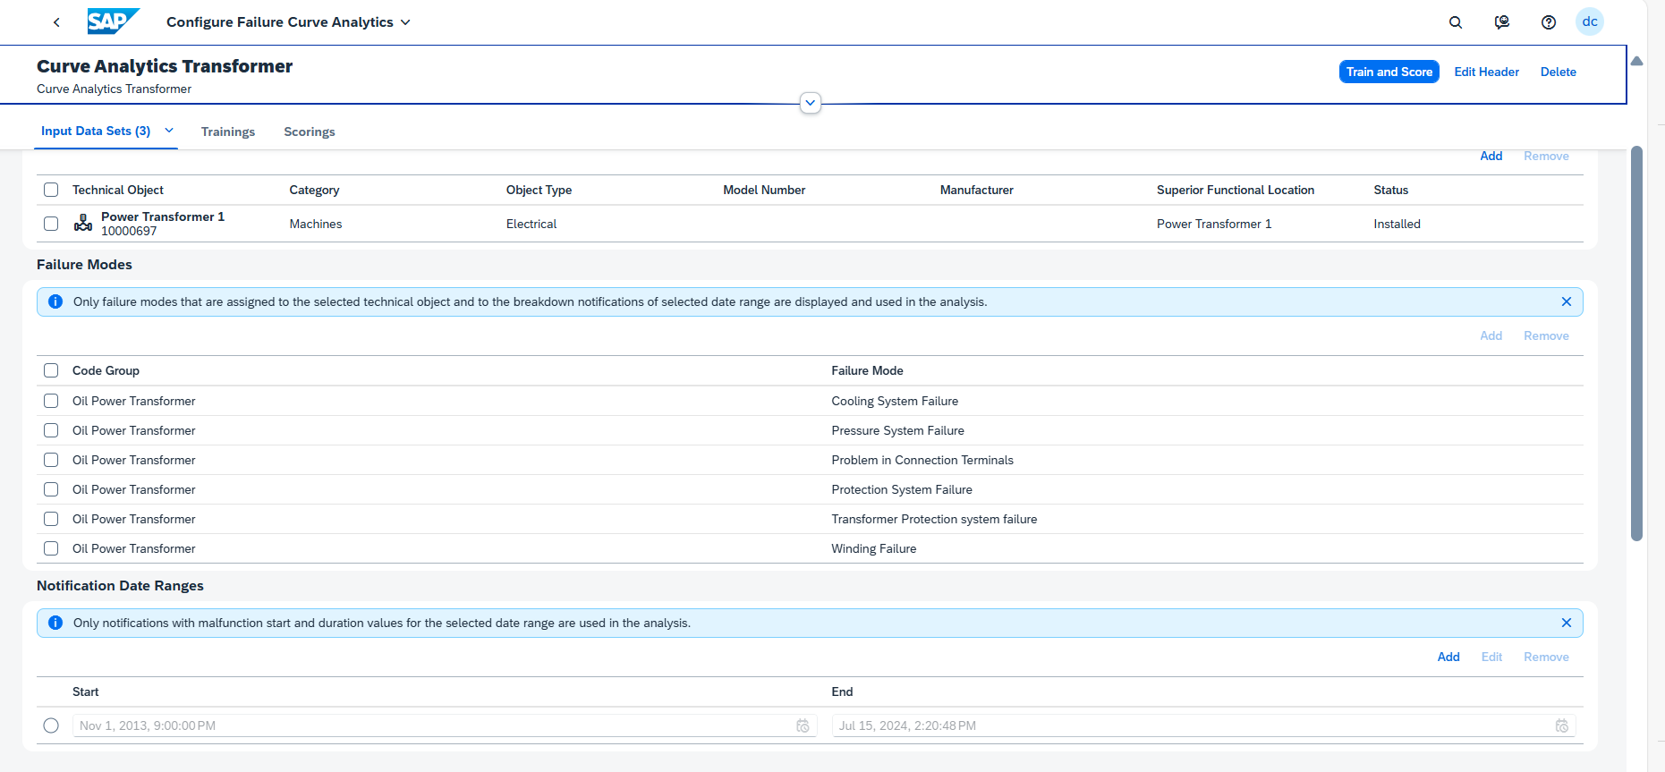
How to create a Model Training? Step by Step

Slide 8
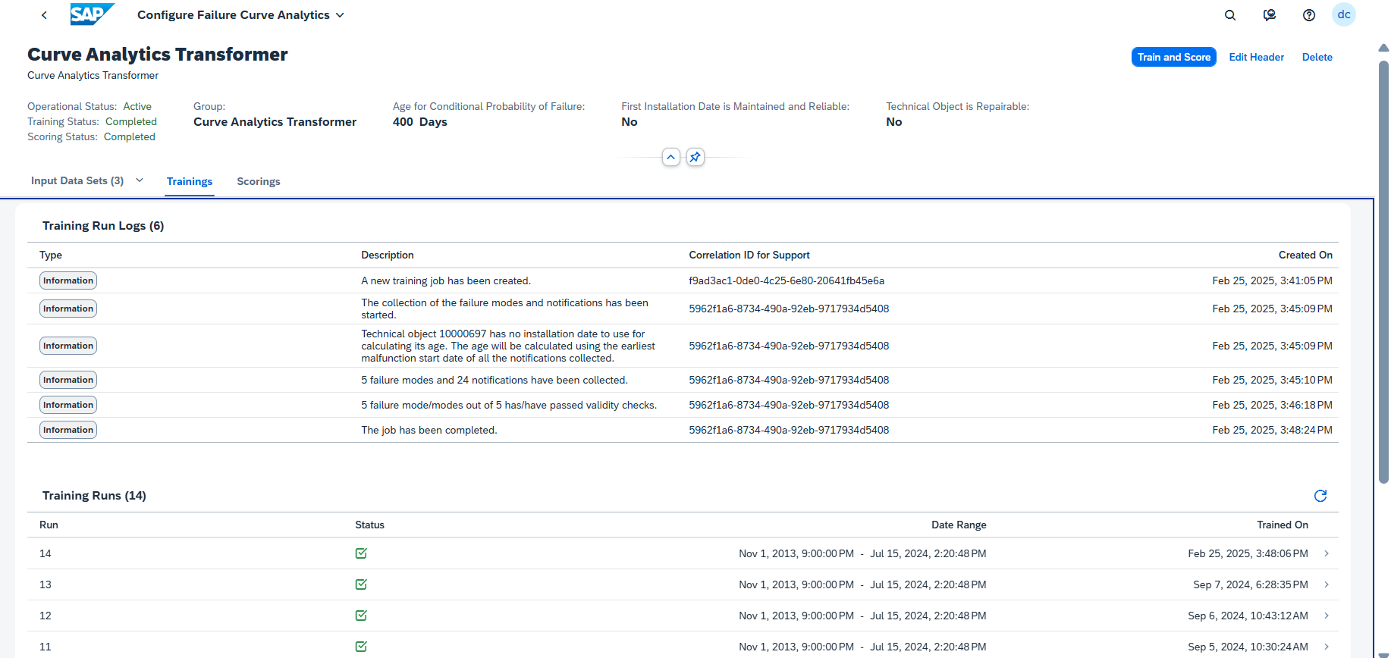
How to create a Model Trainning? Step by Step

Slide 9
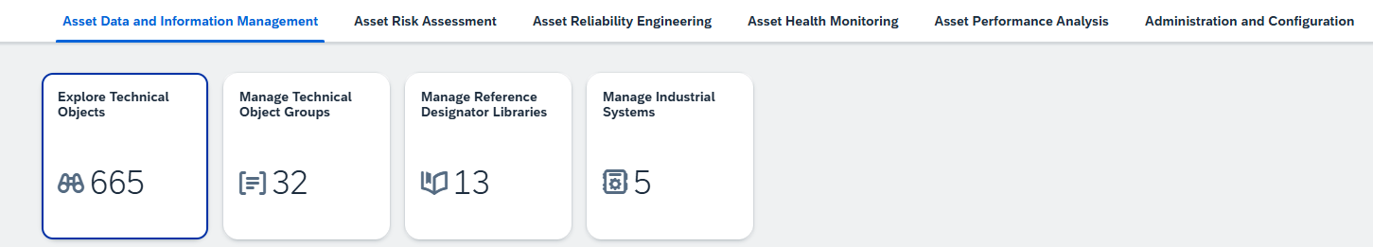
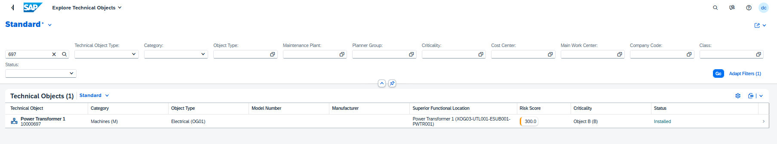
Where can I visualize Failure Curves Analytics? Step by Step

Slide 10
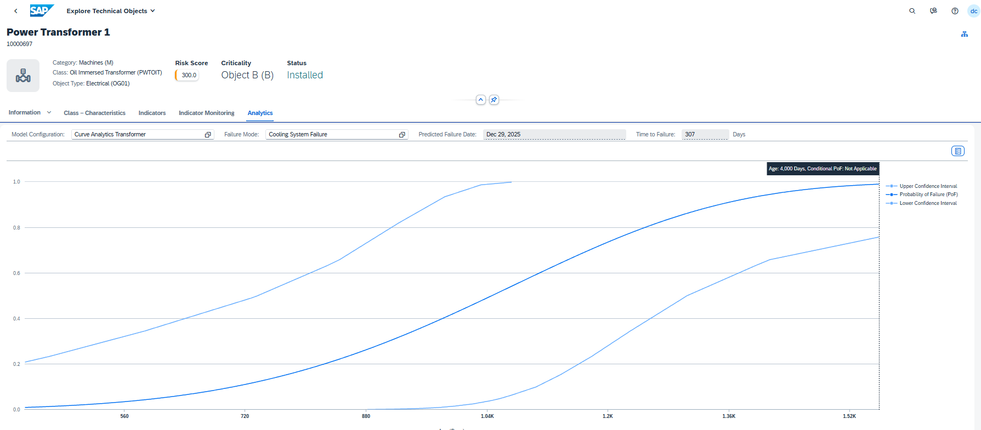
Where can I visualize Failure Curves Analytics? Step by Step

